Slide 1
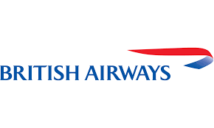
British Airways
Data Science Task 1
Aditya Anandarajan

Slide 2
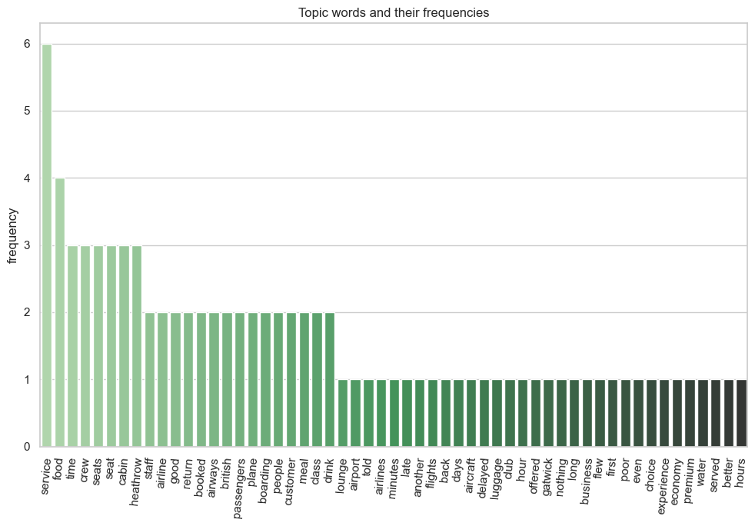
Customer Review Analysis
Keywords for the Topics from Negative Customer Reviews
seat, lounge, meal, staff
Luggage, seat
Experience, cabin, boarding
Drink, Poor, return
Late, boarding, service
Delayed, service, luggage
Sentiment Analysis
74.4% Positive Reviews
25.6 % Negative Reviews

